Slide 1
Module 3
Asymmetric Encryption Algorithm and Key Exchange
Topic
Elliptic Curve Cryptography (ECC) – Generating Points

Slide 2
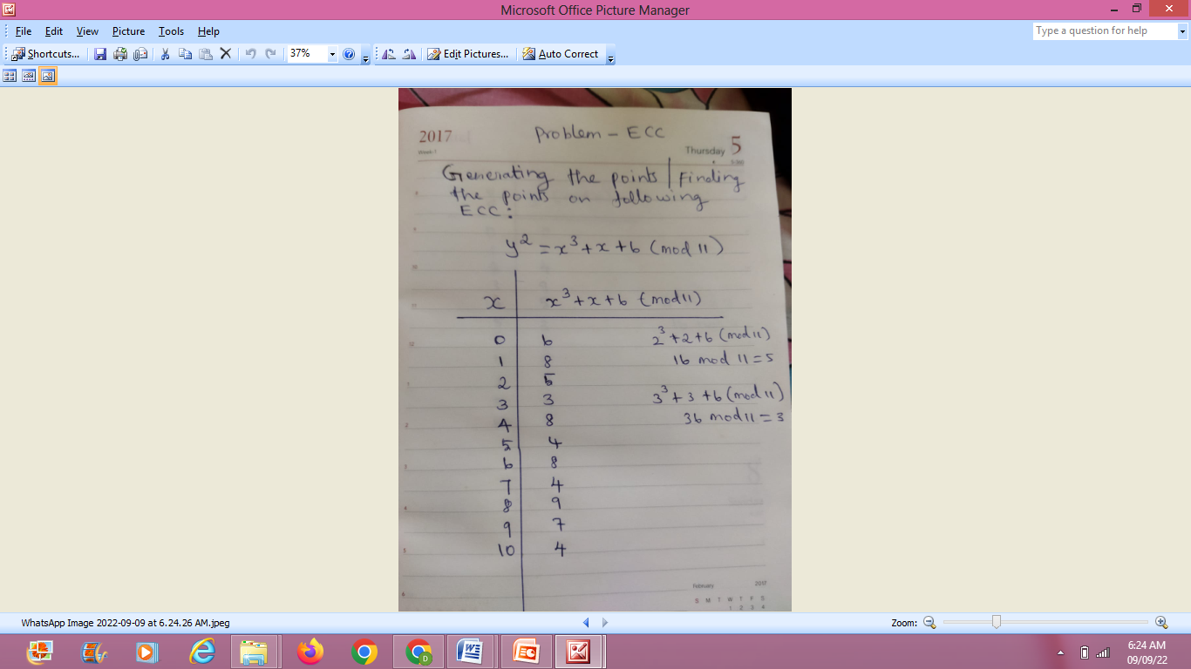

Slide 3
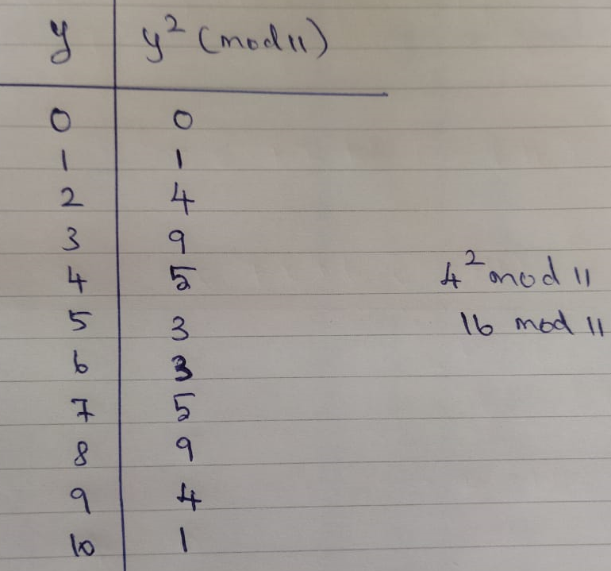


Slide 4
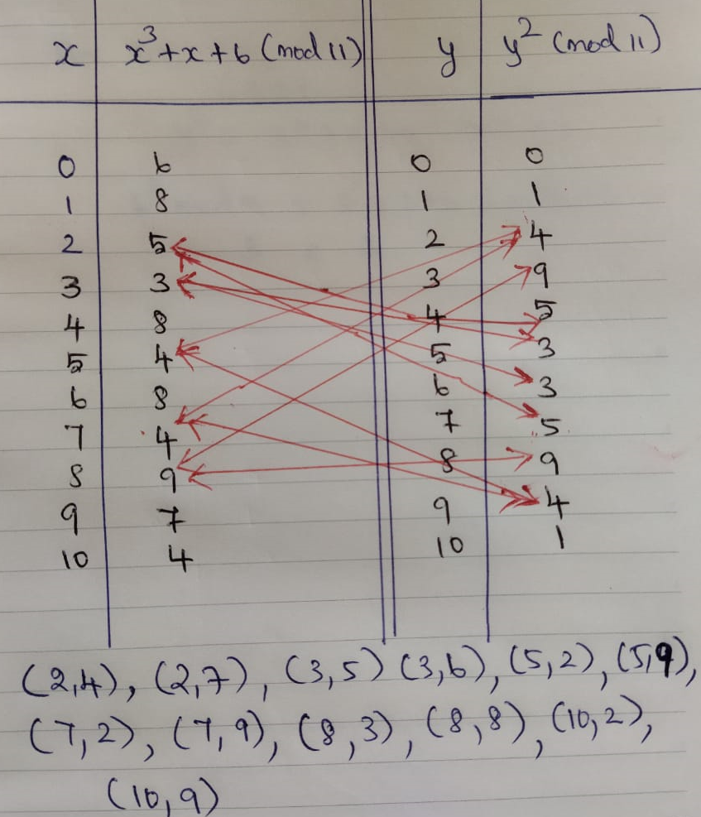

Slide 5
